Slide 1

Communicating with Data
Phillip.lear@kellogg.com

Slide 2
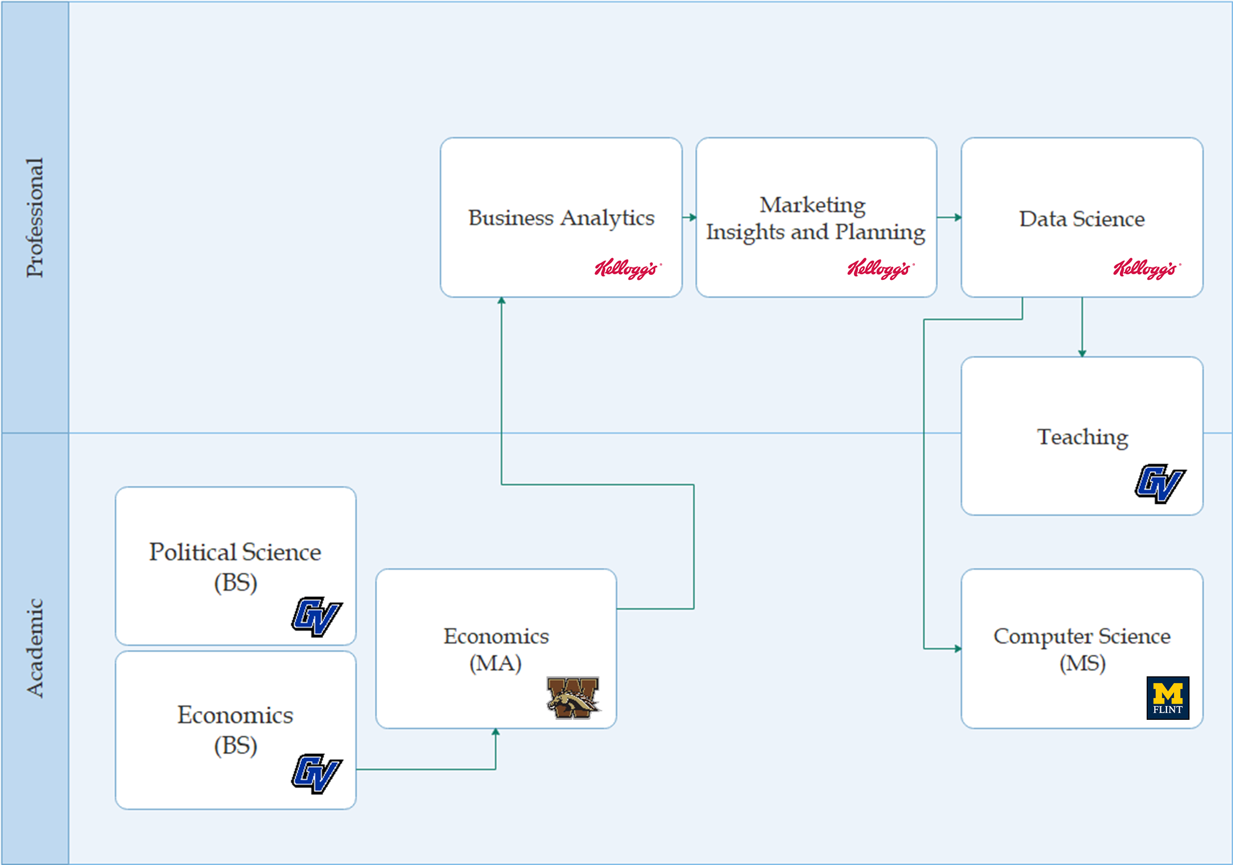


About me
linkedin.com/in/philliplear

Slide 3





Agenda
https://github.com/plear/GVSU_EconClubPrez

Slide 4
Expressing information
“In God we trust.
All others must bring data.” W. Edwards Deming

Slide 5
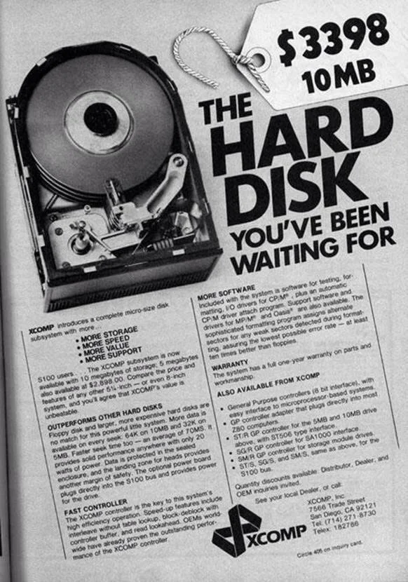
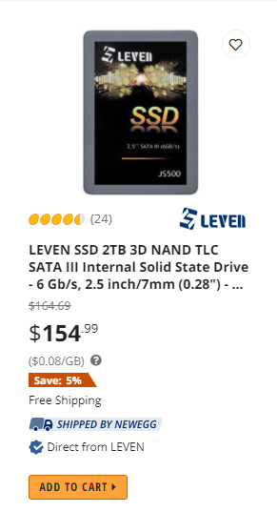
WHY SO MUCH DATA?
2,942.9 bytes / $
~ 3 images from phone
~ $1132.67 per image
588,581,519 bytes / $
~ 500,000 images from phone
~ $0.000308 per image

Slide 6
Data vs Information vs Insight

Slide 7

Simple Data
Which does a better job of conveying information?
“Our share of category is up year over year.”

Slide 8
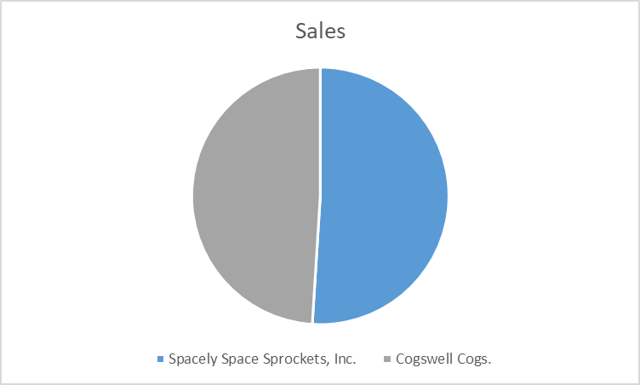
Simple Data
Which does a better job of conveying information?

Slide 9
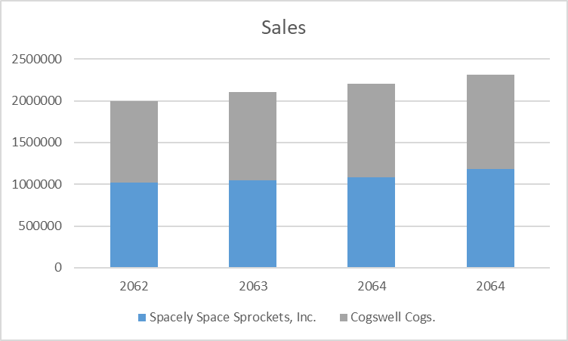
Simple Times Series Data
Which does a better job of conveying information?

Slide 10
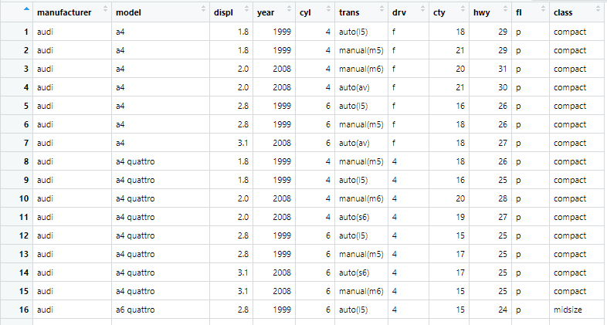
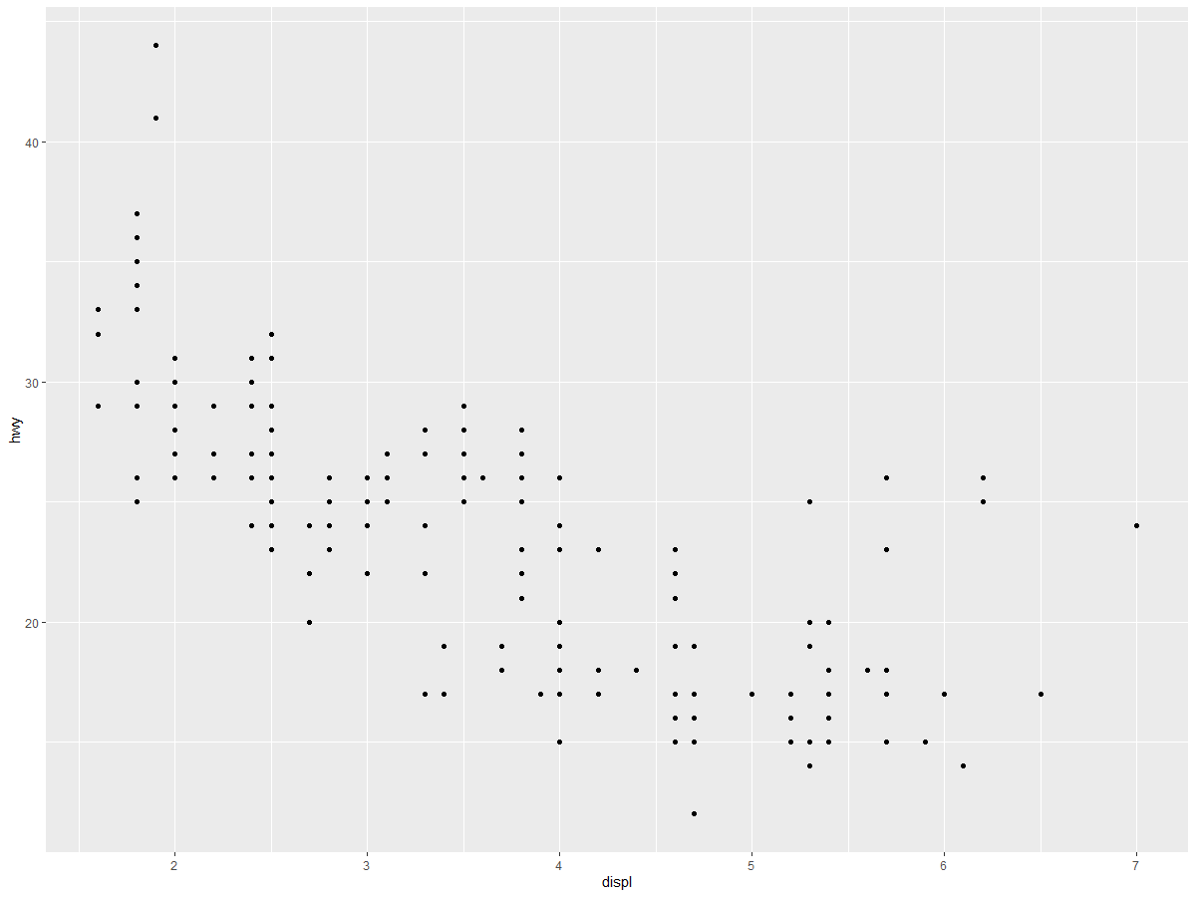
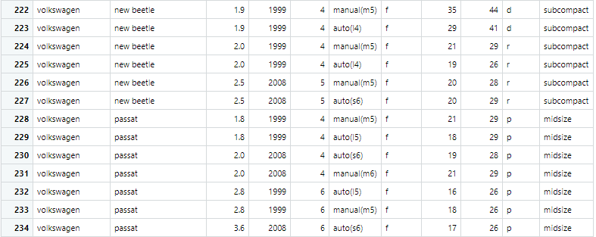
Small data sets with multiple factors
Are these comparable?
{…}

Slide 11
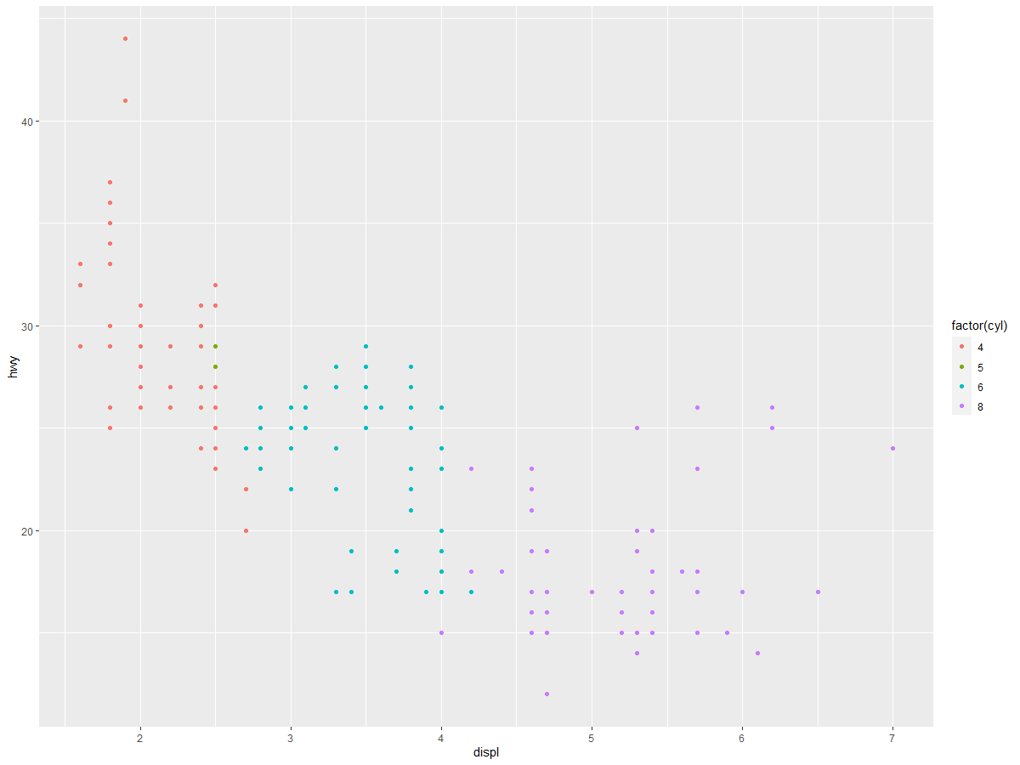
Small data sets with multiple factors
Are these comparable?
{…}

Slide 12
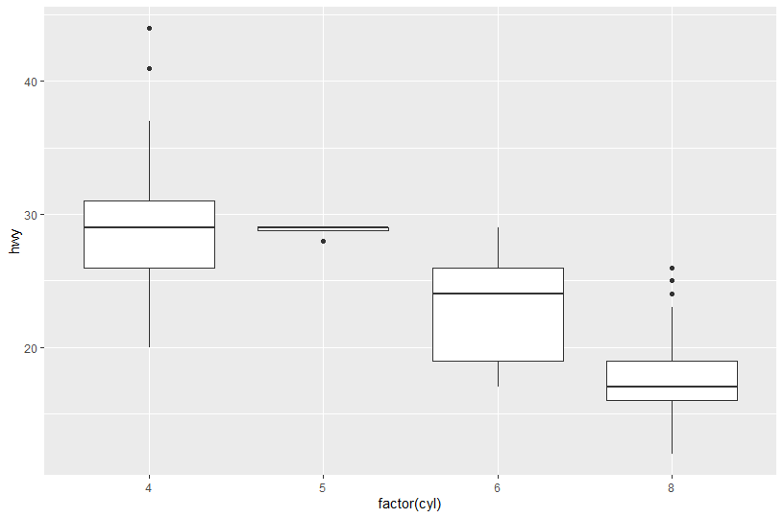
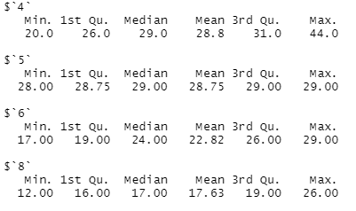
Analysis of summary statistics
Which tells a better story?

Slide 13
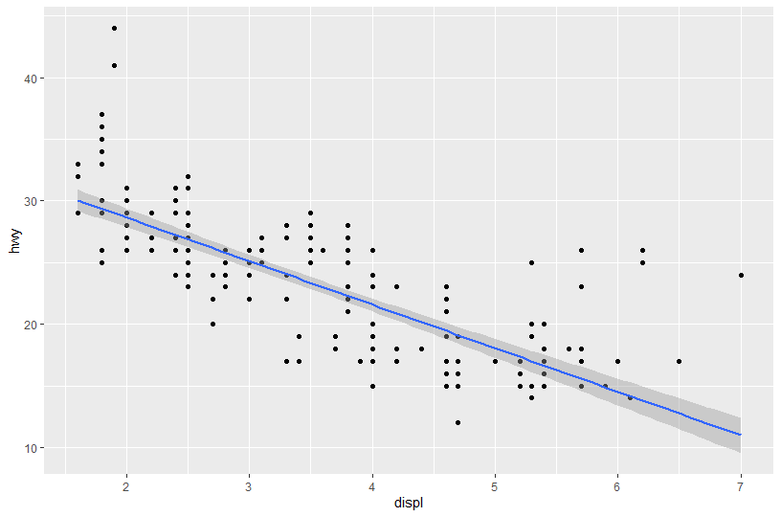
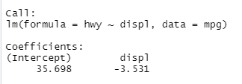
Analysis of modeled data
Which tells a better story?

Slide 14
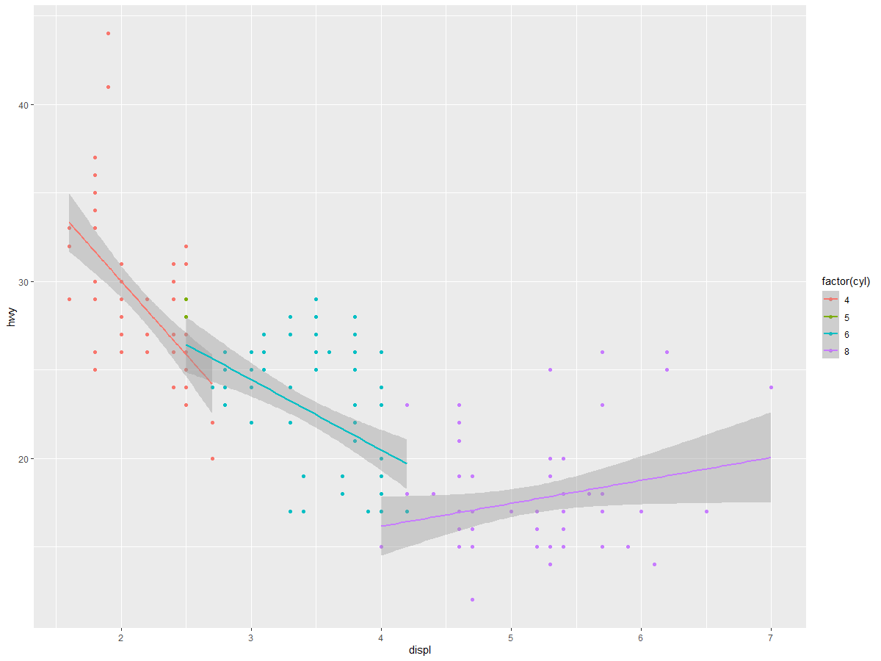
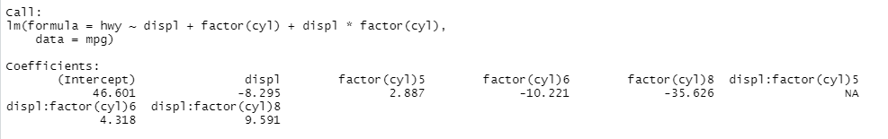
Analysis of modeled data
Which tells a better story?

Slide 15



The grammar of graphics
Coding example In R using ggplot2 library

